Slide 1
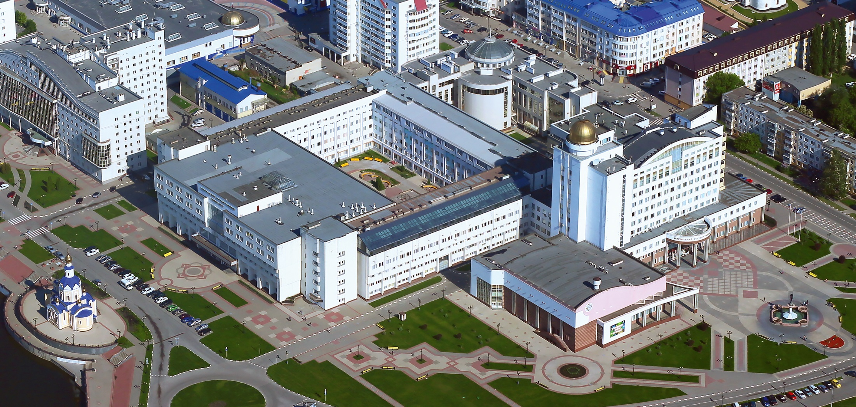

Federal State Autonomous Educational Institution of Higher Education ”Belgorod State University”
Highly effective thermoelectric converter
Head of research laboratory of technological systems at Belgorod State University
Sergeev Sergei Valerevich

Slide 2

Highly effective thermoelectric converter
Activity wording of innovative project
Producing devices which are intended for converting heat of low-grade sources of energy into electrical energy using highly effective rotary thermal machines of volumetric action
Scientific and technical importance
The project involves manufacturing a prototype of industrial thermoelectric converter of a rated power 100 kW with a heat exchanger built into a heating boiler and with a built-in condenser with external coolant supply. This allows us to achieve high efficiency rates of converting heat into electric power, which is impossible to achieve for turbomachines and thermal converters of direct action
2

Slide 3
Uniqueness and advantages of the project
Its use as an actuator of reversible rotary machine of volumetric action electric generator
Optimal filling level of chamber with the working medium is managed without using any valve devices which slow down the work of an actuator and reduce its effectiveness
Possibility of throttling of working medium expansion chamber for the actuator power control, change of expansion ratio of working medium in chamber in dynamic mode
The use of new materials and coatings which ensure minimization of friction at high service life
The use of modern reinforced silicon carbide composite materials which are used for manufacturing sealing elements
3

Slide 4
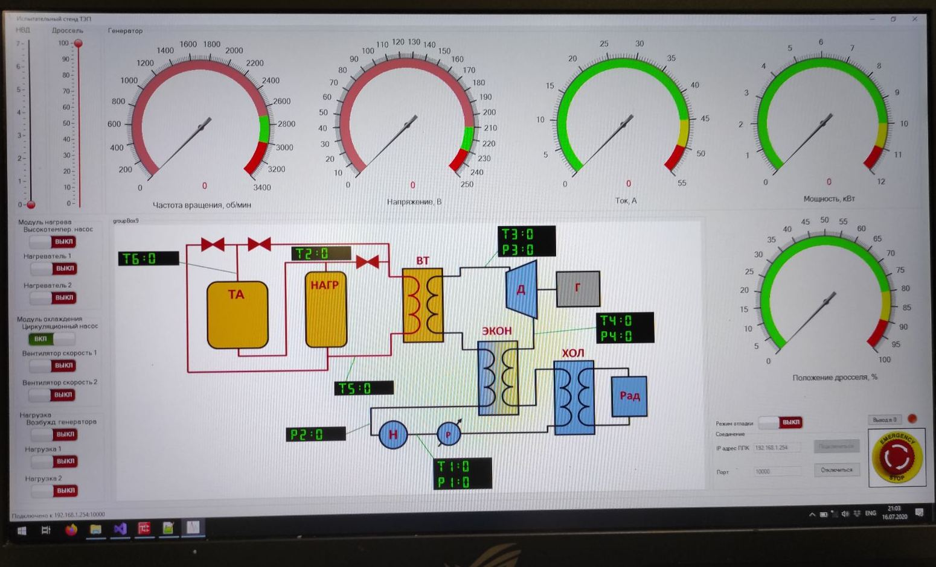
Highly effective thermoelectric converter
The main technical characteristics:
System rated voltage 380 ±15 V in the whole range of permissible loads
Rated power 100 kW ± 5%
Overall efficiency index of energy conversion is no less than 65±2%
Maximum (short-time) power is up to 120 kW in 300 seconds
Type of current – three-phase sinusoidal
Test bench management program (main window)
4

Slide 5
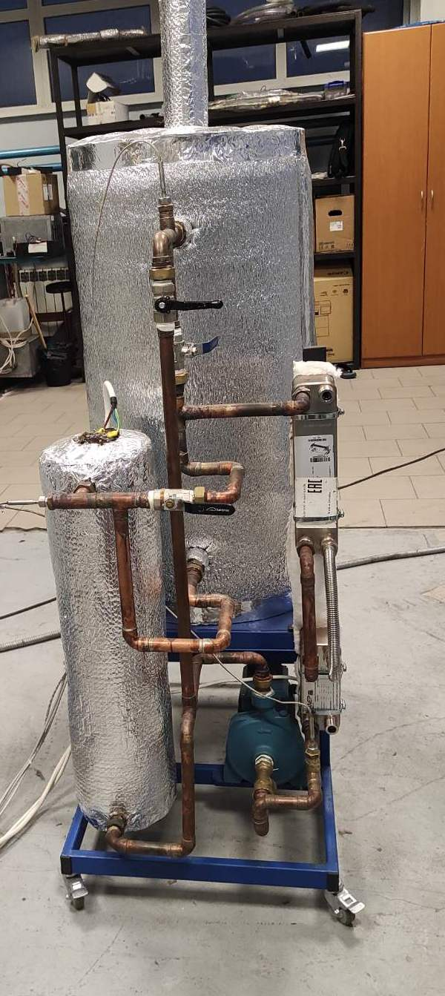
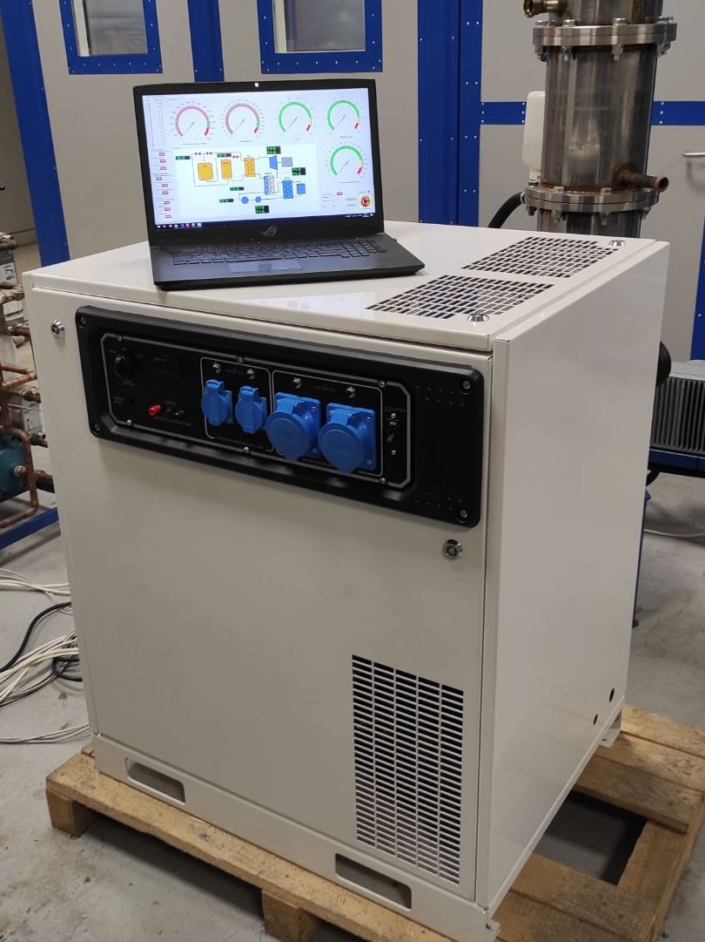
Highly effective thermoelectric converter
Field of application
Recycling of thermal emissions at industrial enterprises
Self-contained mini CHP plants for remote industrial sites and private housing projects
Recycling of industrial and domestic wastes, agricultural enterprises’ wastes with obtaining organic fertilizers and electric power
Minimizing thermal losses of power plants
Fig. 1 Heat source with heat accumulator in the test
bench
Fig. 2 Prototype thermoelectric converter with a rated
power of 9 kW
5

Slide 6
85, Pobedy St., Belgorod, 308015, Russia
Federal State Autonomous Educational Institution of Higher Education ”Belgorod State University”
т. (4722) 30-12-11, ф. (4722) 30-10-12
^{Belgorod.State.University}
^{niu_belgu}
^{beluniversity}
^{media_bsu}
^{BelgorodUniversity}

